Slide 1


ParkEZ App Menu Structure

Slide 2
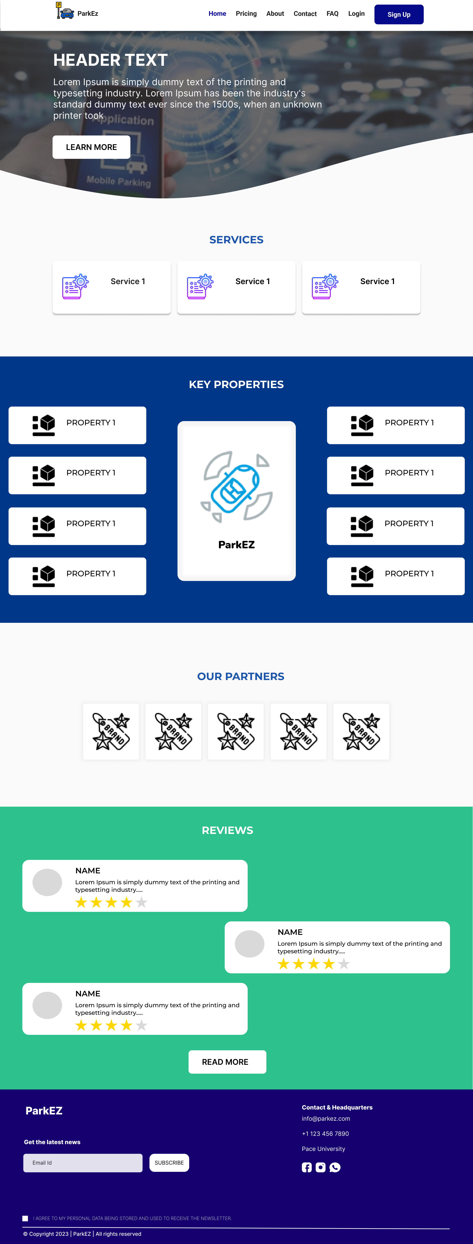
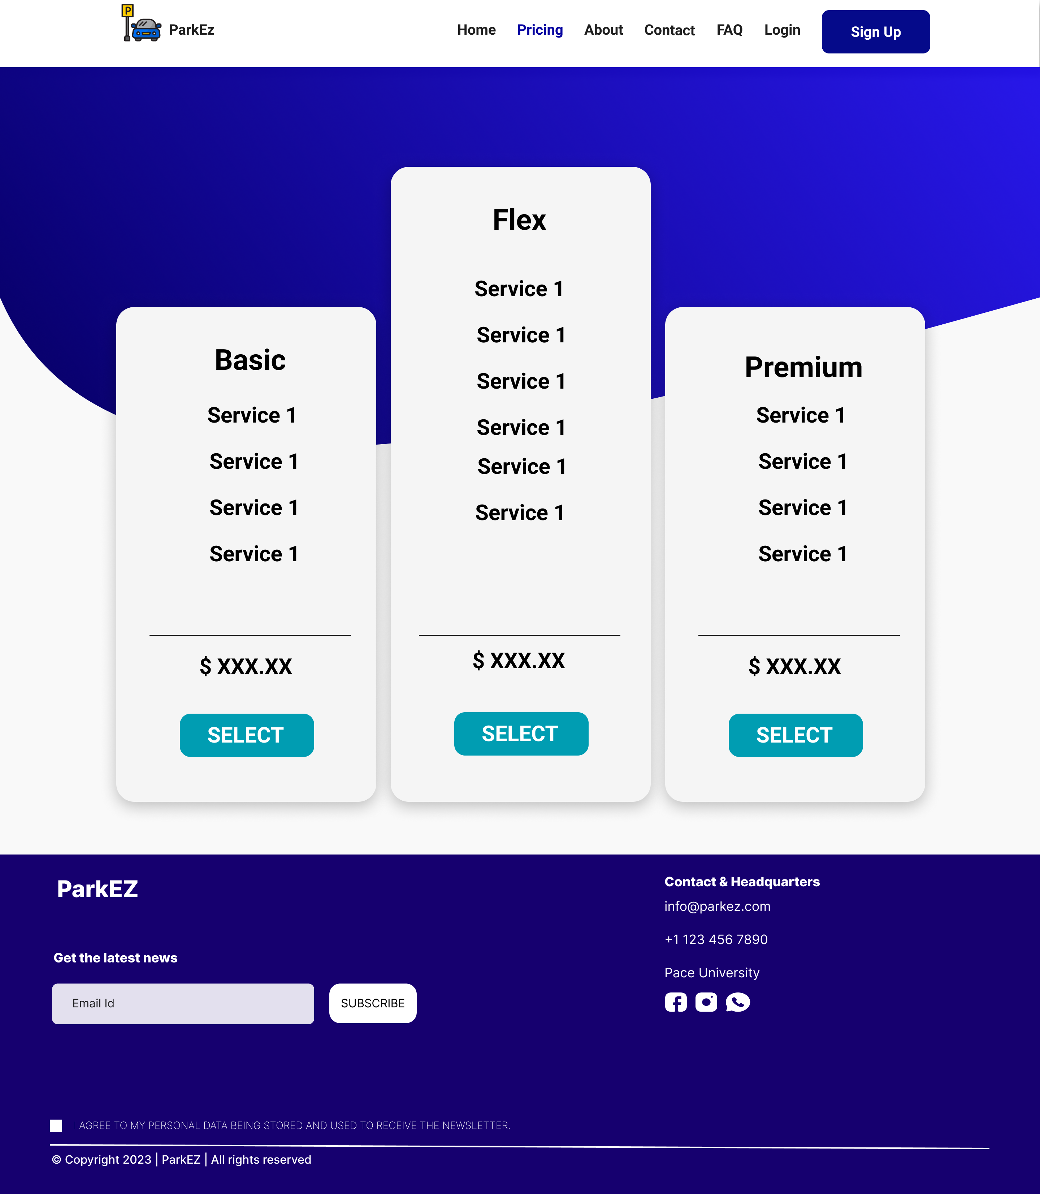
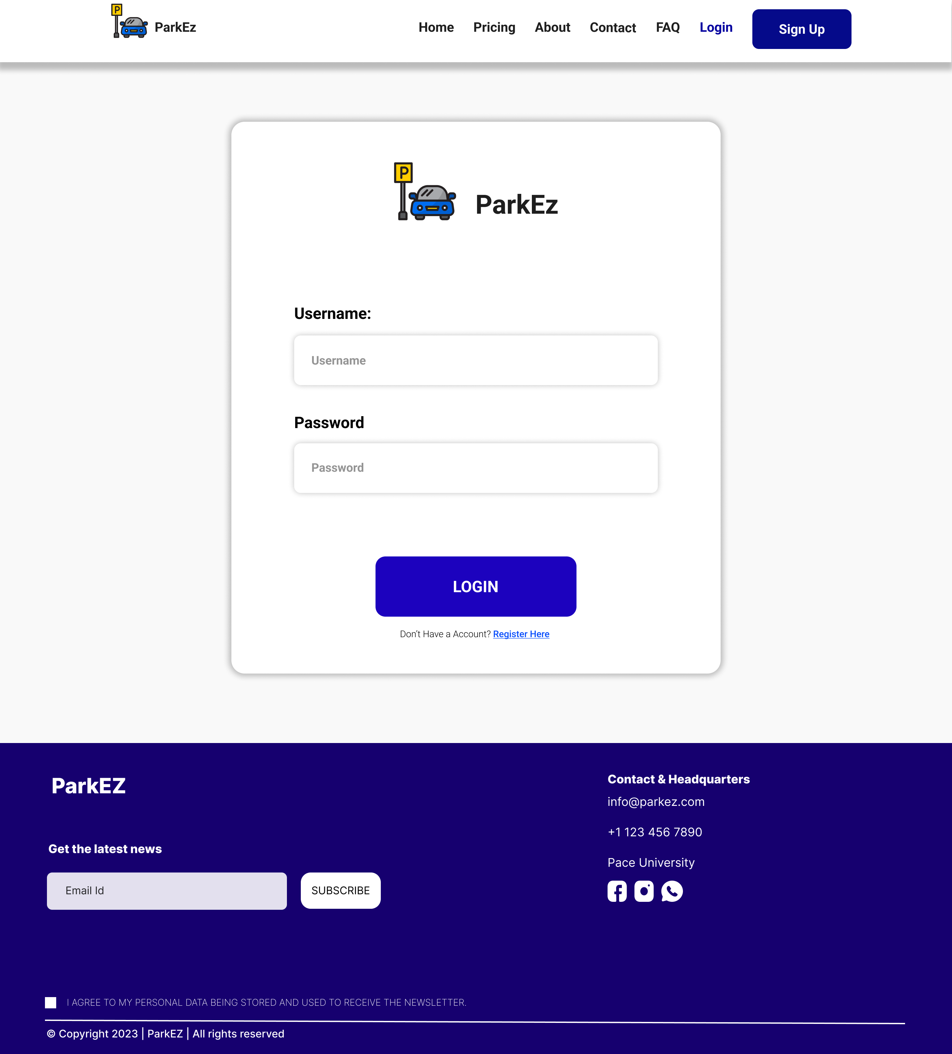

Slide 3
Tabs Navigation
Pricing
The Pricing information screen provides the services and features provided in each subscription plan.
About
The about page displays information about the company, team, awards, and testimonials.
Contact
Gives the contact information of the company to the users.
FAQ
The frequently Asked Questions page is given so that common questions of users can be solved without searching and wasting time on the topic.

Slide 4
Tabs Navigation
Login
Users log into their business/personal account via login button to manage information.
Sign Up
The users who’re not registered to the service can register themselves via the signup button

Slide 5
More Information
Implementation
The images depicting the menu within the presentation comprise screenshots of the application captured during its present developmental stage.
Styling
The images in the presentation serve as temporary placeholders to illustrate the menu structure, and do not reflect the final product's color scheme or overall style. The design elements will be refined and integrated during the development process, while the navigation's position and functionality will remain unchanged.
Code Base
Our team has leveraged a suite of cutting-edge technologies - including ReactJS, HTML, CSS, JavaScript, JSX, and SCSS - to craft a high-performance application. Access to the application is facilitated through our team's GitHub Project Repository, which allows for seamless collaboration and version control throughout the development process.

